Slide 1
BCoT BlockChain of Things
Integration of Blockchain with IoT

Slide 2
PROBLEMS
01
IOT
02
BCOT
TABLE OF CONTENTS
04
BLOCKCHAIN
03
5G NETWORK
05
CHALLENGES
06
The problems of
Incumbent industry
Introduction and Challenges of
Internet of Things
Opportunities and Design of
Integrating Blockchain with IoT
Functions and Structure of
Blockchain
Blockchain for 5G and after Gen
Potential Issues and Solutions of
BCoT

Slide 3
01
PROBLEMS
The Problems of Incumbent Industry

Slide 4
THE RECENT INDUSTRY
The advance of ICT has connected
the Physical industrial environment to
the Cyberspace of computing systems

Slide 5
Decentralization
INCUMBENT IOT’S
PROBLEMS
Diversity
Heterogeneity
Network
Complexity

Slide 6
02
IOT
Introduction and Challenges of Internet of Things

Slide 7
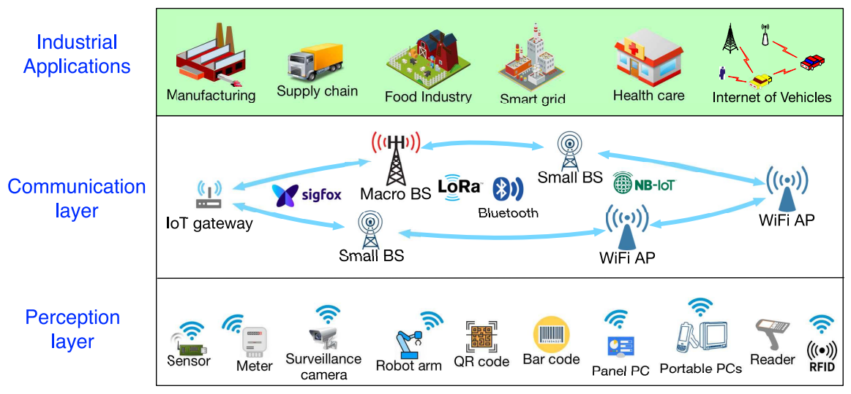
INTRODUCTION OF IOT
INDUSTRIAL APPLICATION
COMMUNICATION
LAYER
PERCEPTION
LAYER

Slide 8
CHALLENGES OF IOT
HETEROGENEITY
COMPLEXITY
INTEROPERABILITY
RESOURCES
PRIVACY
SECURITY

Slide 9
03
BLOCKCHAIN
Functions and Structures of Blockchain

Slide 10
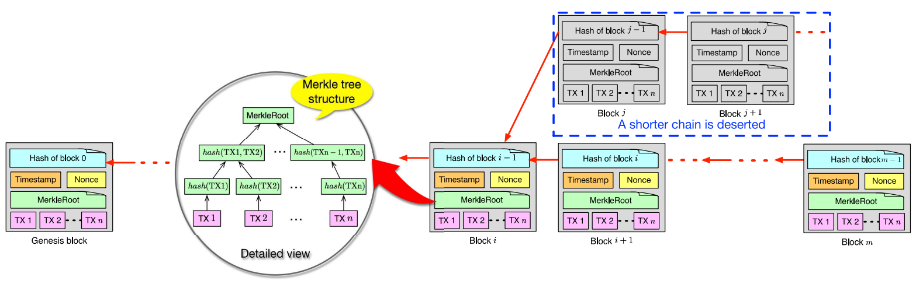
STRUCTURES OF BLOCKCHAIN

Slide 11
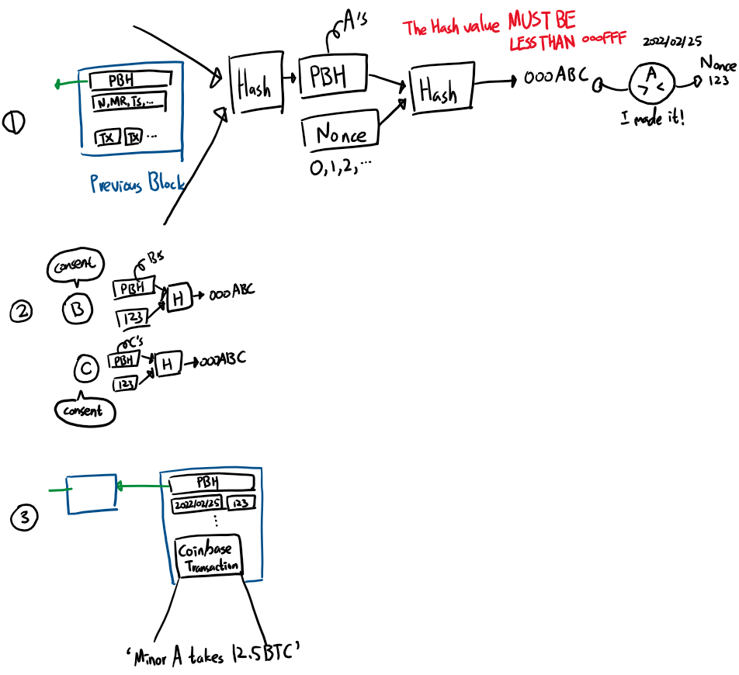
CONSENSUS ALGORITHMS OF BLOCKCHAIN
PROOF OF WORK

Slide 12
STRUCTURES OF BLOCKCHAIN

Slide 13
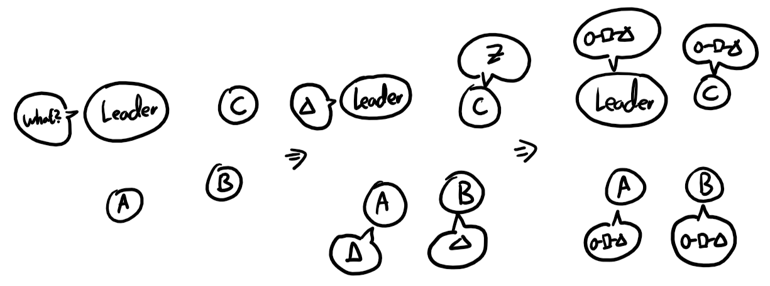
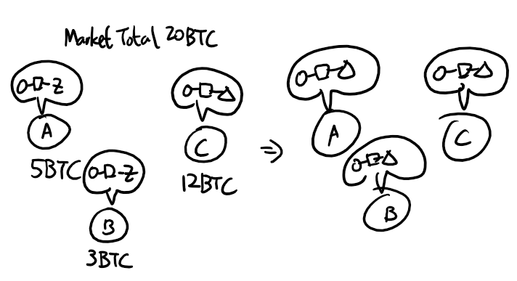
CONSENSUS ALGORITHMS OF BLOCKCHAIN
PROOF OF STAKE
PRACTICAL BYZANTINE
FAULT TOLERANCE

Slide 14
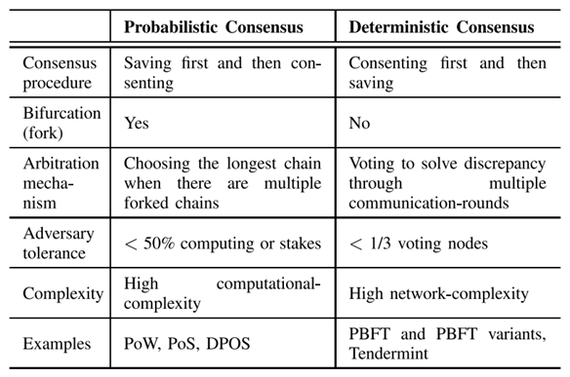
CONSENSUS ALGORITHMS OF BLOCKCHAIN
TAXONOMY OF
TYPICAL CONSENSUS
ALGORITHMS

Slide 15
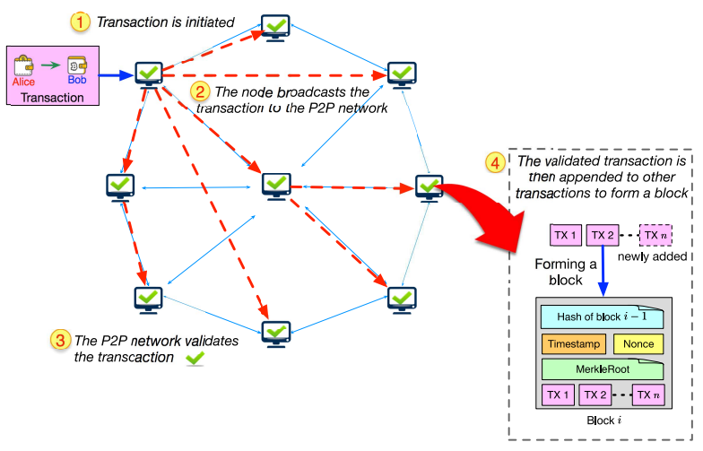
METHOD OF BLOCKCHAIN TRANSACTION
COMMUNICATION
LAYER

Slide 16
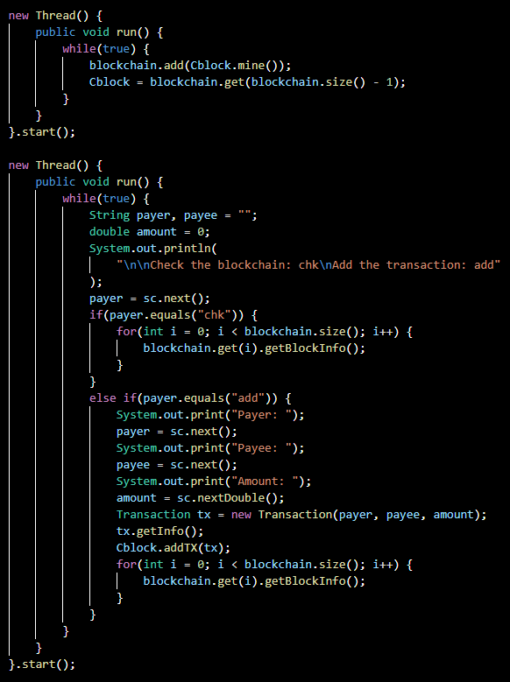
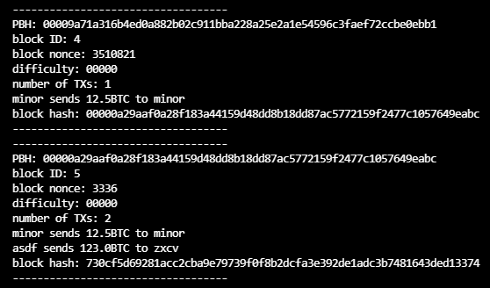
STRUCTURES OF BLOCKCHAIN

Slide 17
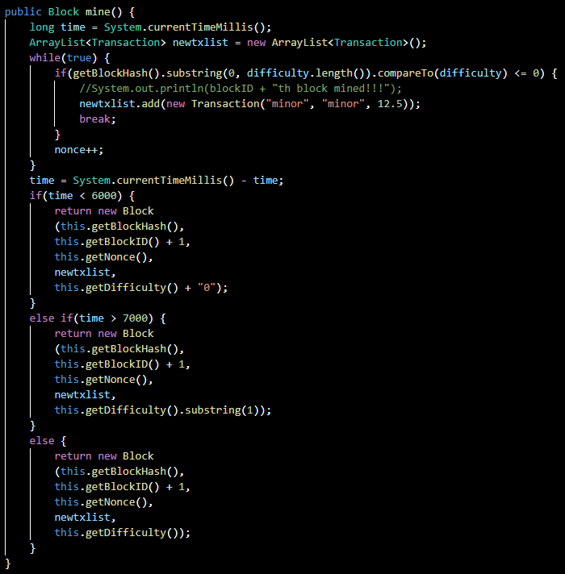
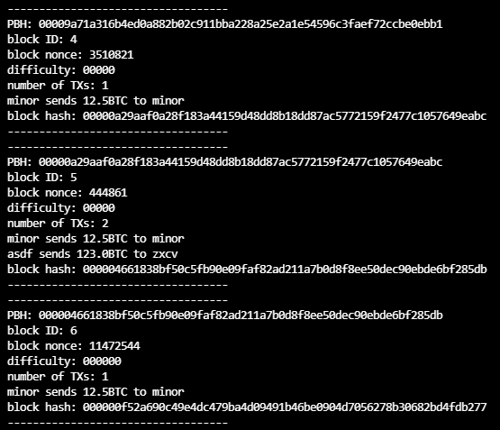
STRUCTURES OF BLOCKCHAIN

Slide 18
KEY CHARACTERISTICS OF BLOCKCHAIN
DECENTRALIZATION
TRANSPARENCY
IMMUTABILITY
PSEUDONYMITY
NONREPUDIATION
TRACEABILITY

Slide 19
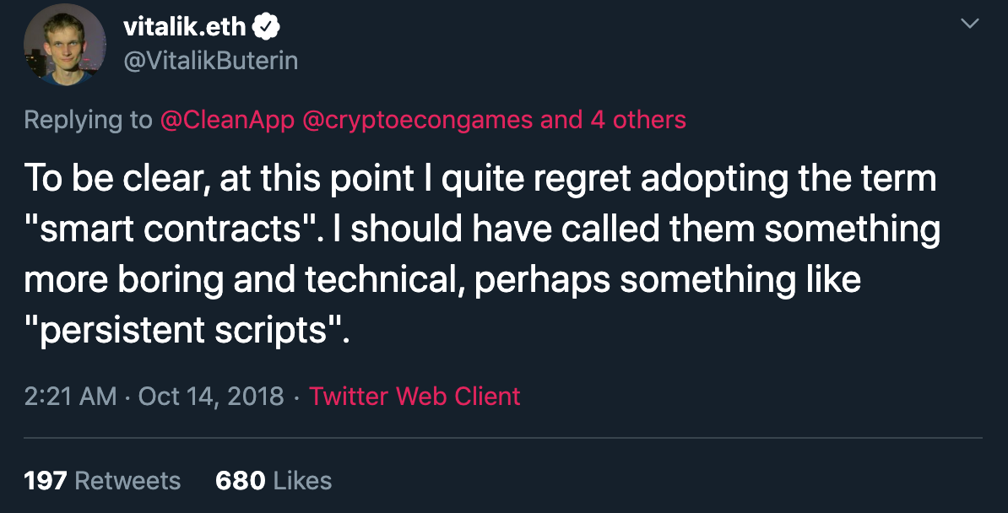
SMART CONTRACTS
… or maybe Persistent scripts

Slide 20
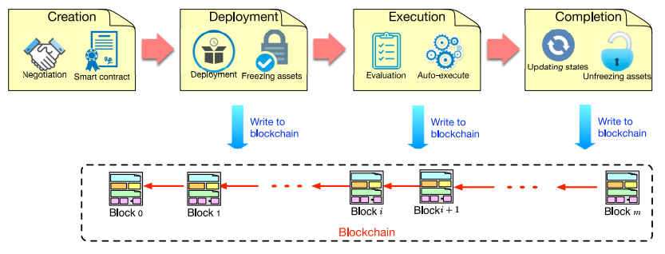
SMART CONTRACTS
LIFE CYCLE OF SMART CONTRACTS

Slide 21
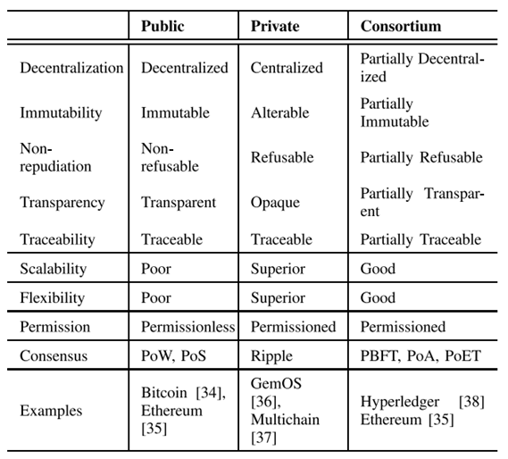
BLOCKCHAIN SYSTEMS
COMPARISONS OF BLOCKCHAIN SYSTEMS

Slide 22
04
BCOT
Opportunities and Design of Integrating Blockchain with IoT

Slide 23
CHALLENGES OF IOT
HETEROGENEITY
COMPLEXITY
INTEROPERABILITY
RESOURCES
PRIVACY
SECURITY

Slide 24
OPPORTUNITIES OF BCOT
HETEROGENEITY
COMPLEXITY
INTEROPERABILITY
RESOURCES
PRIVACY
SECURITY

Slide 25
OPPORTUNITIES OF BCOT
HETEROGENEITY
COMPLEXITY
INTEROPERABILITY
RESOURCES
PRIVACY
SECURITY

Slide 26
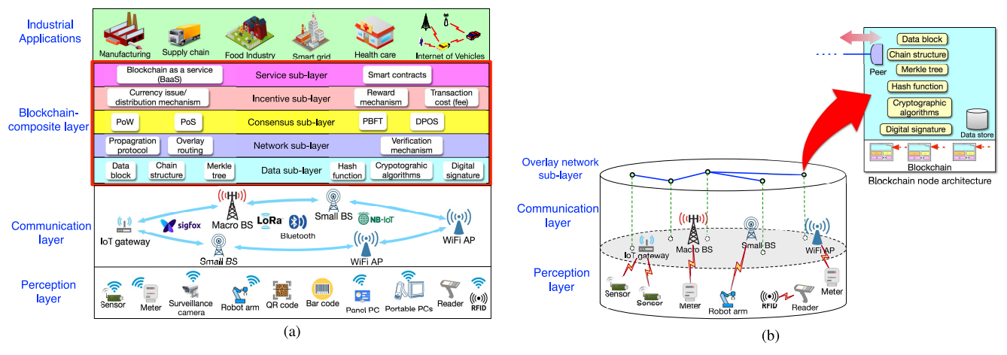
DESIGN OF BCOT
OVERVIEW OF BCOT ARCHITETURES
(a) Blockchain-Composite layer
(b) P2P Overlay Network and Node Architecture

Slide 27
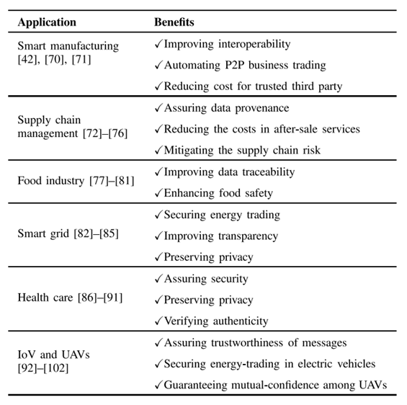
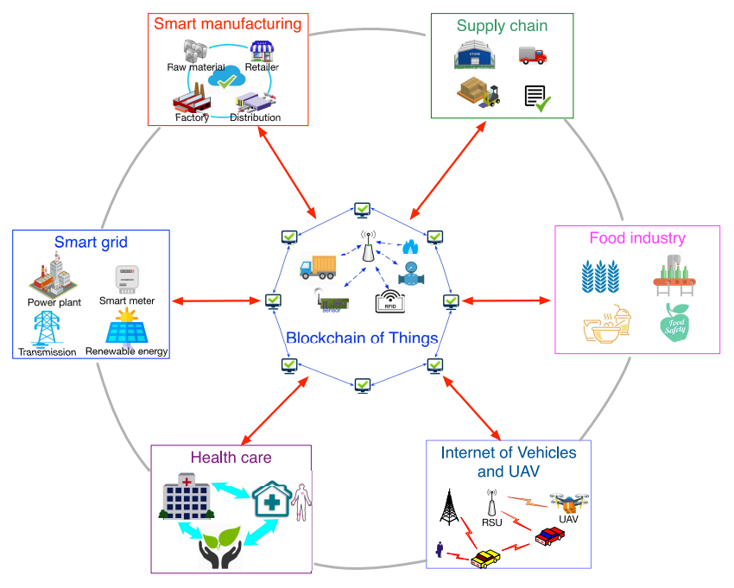
APPLICATION OF BCOT
COMPARISON OF APPLICATION OF
BCOT

Slide 28
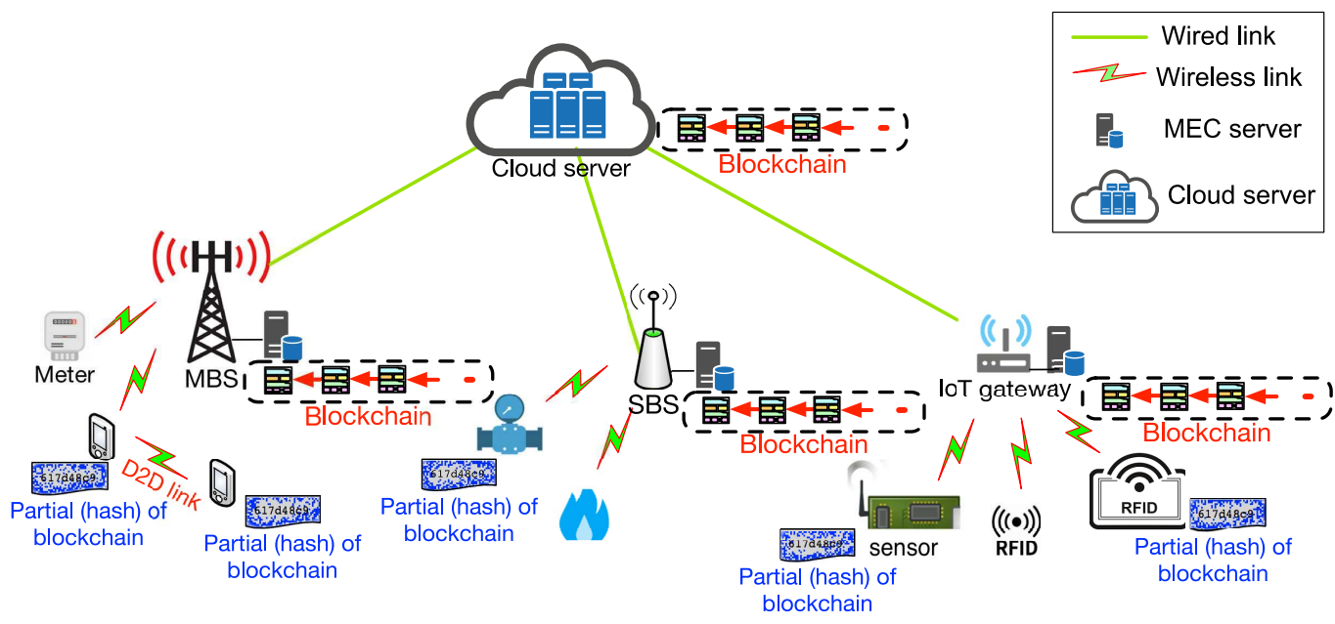
DESIGN OF BCOT
DEPLOYMENT SCENARIO OF BCOT

Slide 29
05
5G NETWORK
Blockchain for 5G and after Generation Network

Slide 30
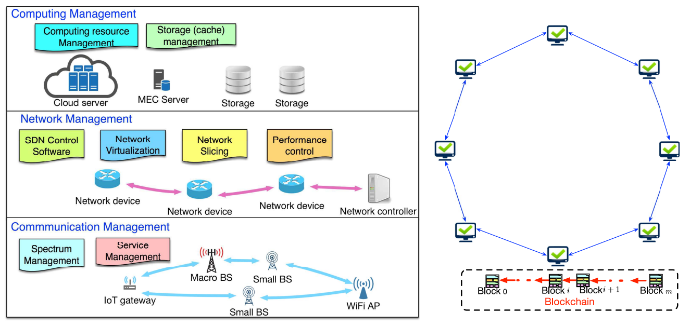
BLOCKCHAIN FOR 5G AND AFTER GEN. NETWORK

Slide 31
06
CHALLENGES
Potential Issues and Solutions of BCoT

Slide 32
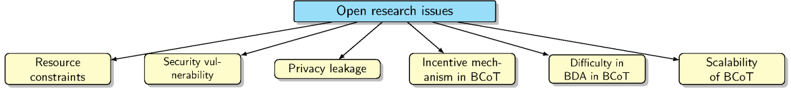
CHALLENGES OF BCOT
CHALLENGES TO BE ADDRESSED
BEFORE BCOT FULLY IMPLEMENT

Slide 33
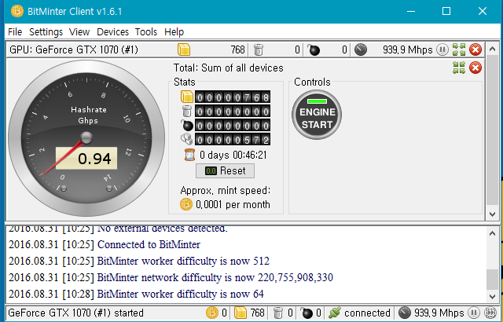
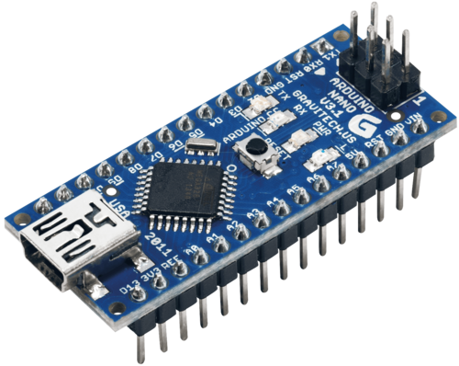
RESOURCE CONSTRAINTS

Slide 34
RESOURCE CONSTRAINTS
MEC, CLOUD COMPUTING
WITH BCOT

Slide 35
SECURITY VULNERABILITY
Ordinary account
A
Ordinary account
B
Attacker account
C
1. Create contract
2. Deposit 50eth
3. Create and transfer 2eth
8. Withdrawal 52eth
Foo
contract
4. Deposit 2eth
Attack
contract
5. Withdrawal 1eth
6. Trans 1eth to the Attack cont & exec fallback() again
7. Execute multiple fallback() -> all eth out

Slide 36
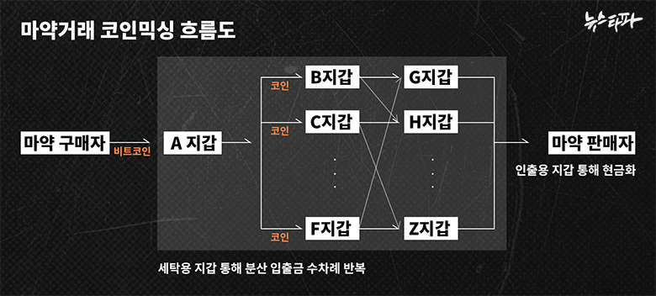
PRIVACY LEAKAGE
COIN
MIXING
METHOD

Slide 37
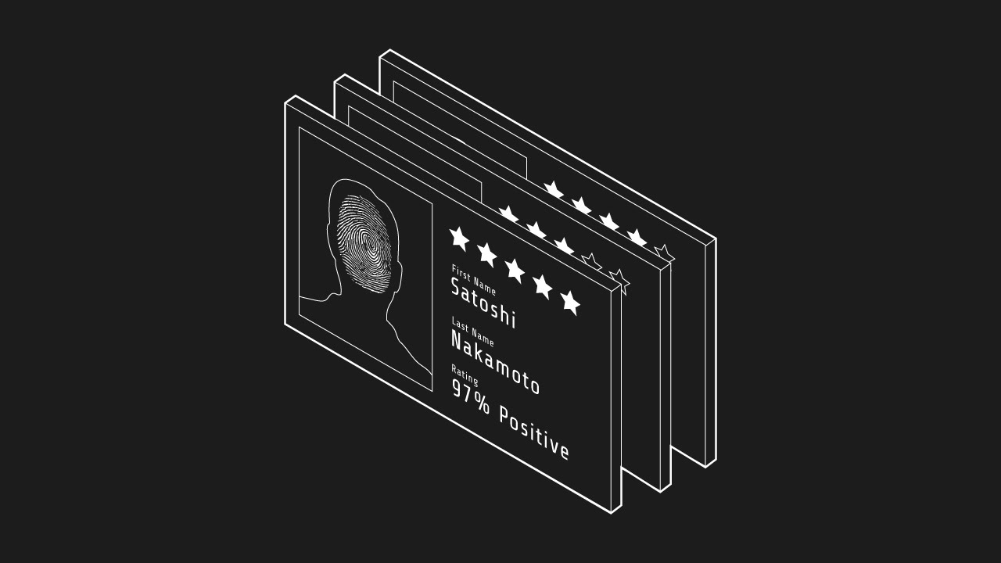
INCENTIVE MECHANISM IN BCOT

Slide 38
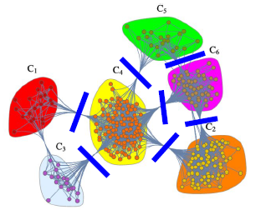
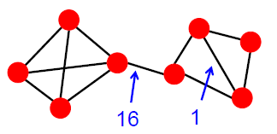
DIFFICULTY IN BDA IN BCOT
COMMUNITY DETECTION OF
ANONYMOUS DATA

Slide 39
SCALABILITY OF BCOT
N(PBFT)
…-z-N
N
z (PoW)
N
N

Slide 40
SUMMARY
j
(Consented)
j
TX
TX
Encrypted TX
A
B
…
B’s IoT
B’s IoT
B’s Confidential
IoT

Slide 41
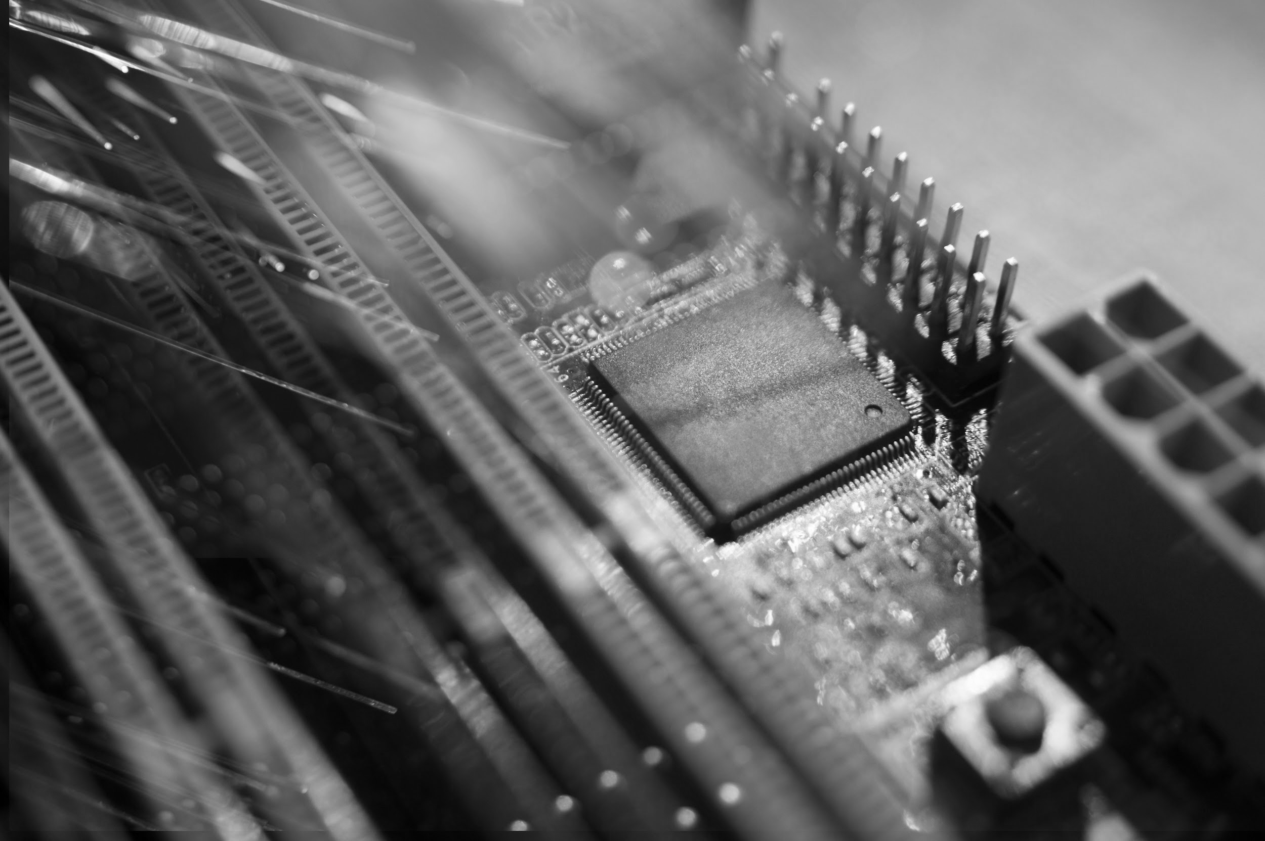
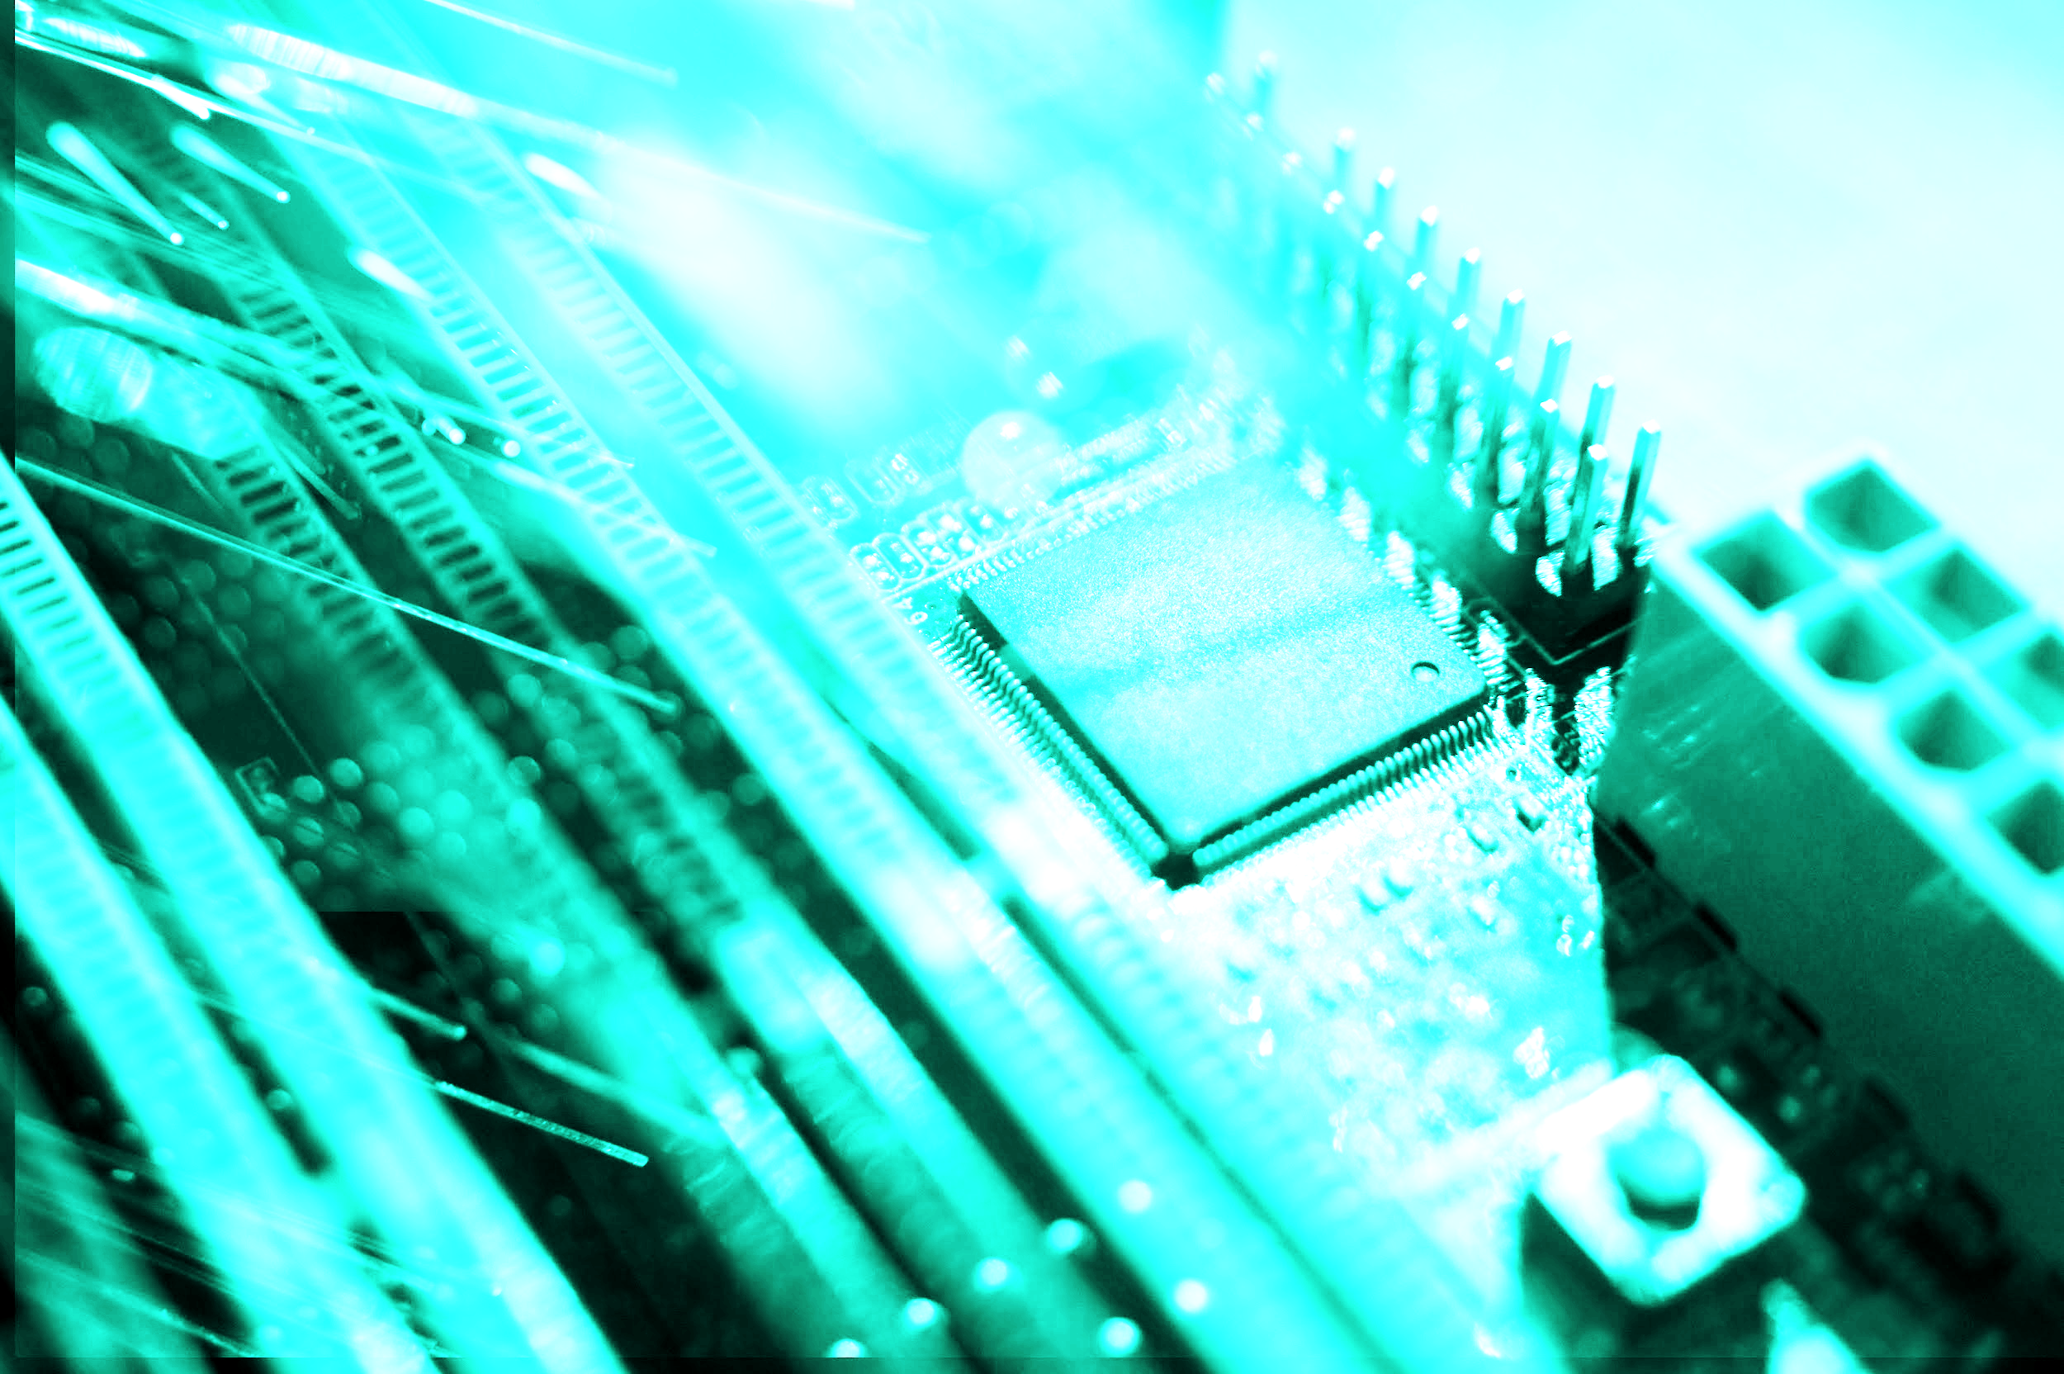
MY OPINION ON BCOT

Slide 42
THANKS
Does anyone have any questions?

Slide 43
THANKS
Does anyone have any questions?

Slide 44
NEWS
NEPTUNE
MARS
MERCURY
JUPITER
VENUS
SATURN
Neptune is the farthest planet from the Sun and the fourth-largest in our Solar System
Despite being red, Mars is a cold place, not hot. It’s full of iron oxide dust, which gives the planet its reddish cast
Mercury is the closest planet to the Sun and also the smallest one in our Solar System
Jupiter is the biggest planet in our Solar System and also the fourth-brightest object in the sky
Venus has a beautiful name and is the second planet from the Sun. It’s terribly hot, even hotter than Mercury
Saturn is the ringed planet. It’s a gas giant, composed mostly of hydrogen and helium

Slide 45








WELCOME!
MARY RUIZ
JOHN SMITH
JONATHAN DOE
MINA HAWKINS
Neptune is the farthest planet from the Sun and the fourth-largest in our Solar System
Despite being red, Mars is a cold place, not hot. It’s full of iron oxide dust, which gives the planet its reddish cast
Mercury is the closest planet to the Sun and the smallest one in our Solar System
Venus has a beautiful name and is the second planet from the Sun. It’s terribly hot, even hotter than Mercury

Slide 46
REVIEW OF PAST EVENTS
Despite being red, Mars is a cold place, not hot
Jupiter is the biggest planet in our Solar System
FEB 02
APR 16
JAN 14
MAR 10
MAY 30
Mercury is the closest planet to the Sun
Saturn is composed of hydrogen and helium
Neptune is the farthest planet from the Sun

Slide 47
UPCOMING EVENTS
SEP 08
Mercury is the closest planet to the Sun
NOV 29
Saturn is composed of hydrogen and helium
OCT 16
Despite being red, Mars is a cold place, not hot
DEC 10
Jupiter is the biggest planet in our Solar System

Slide 48
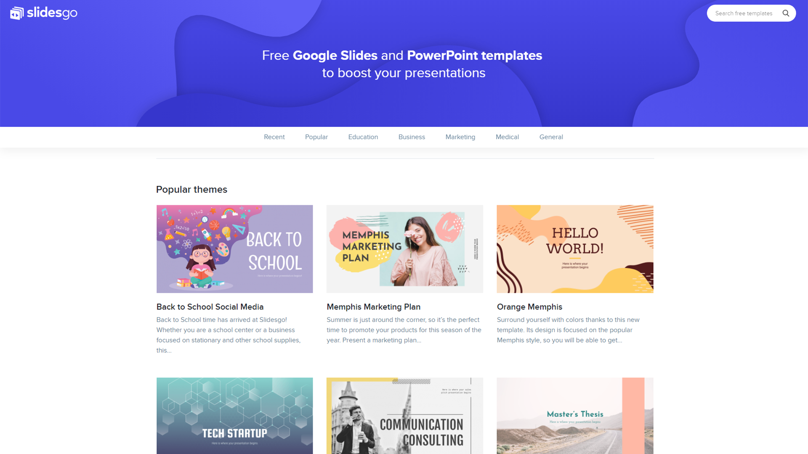
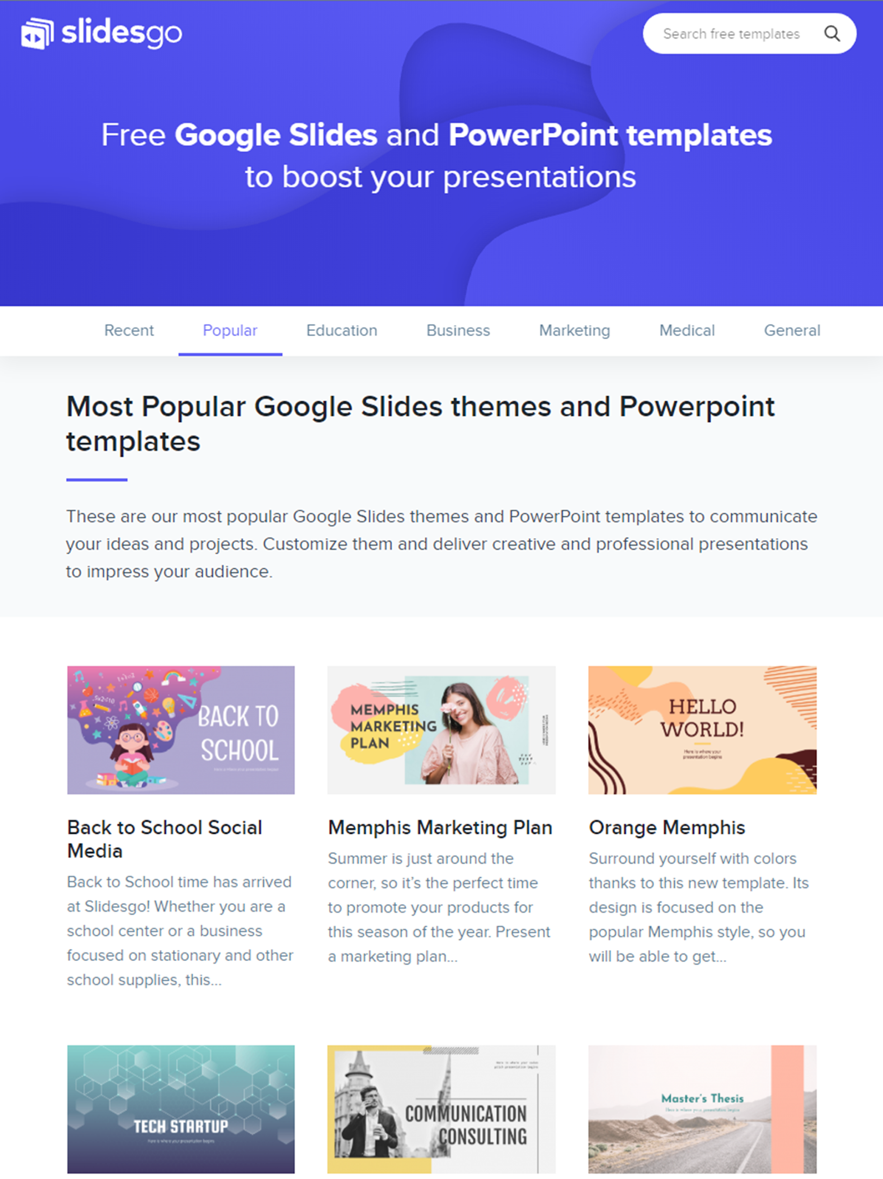
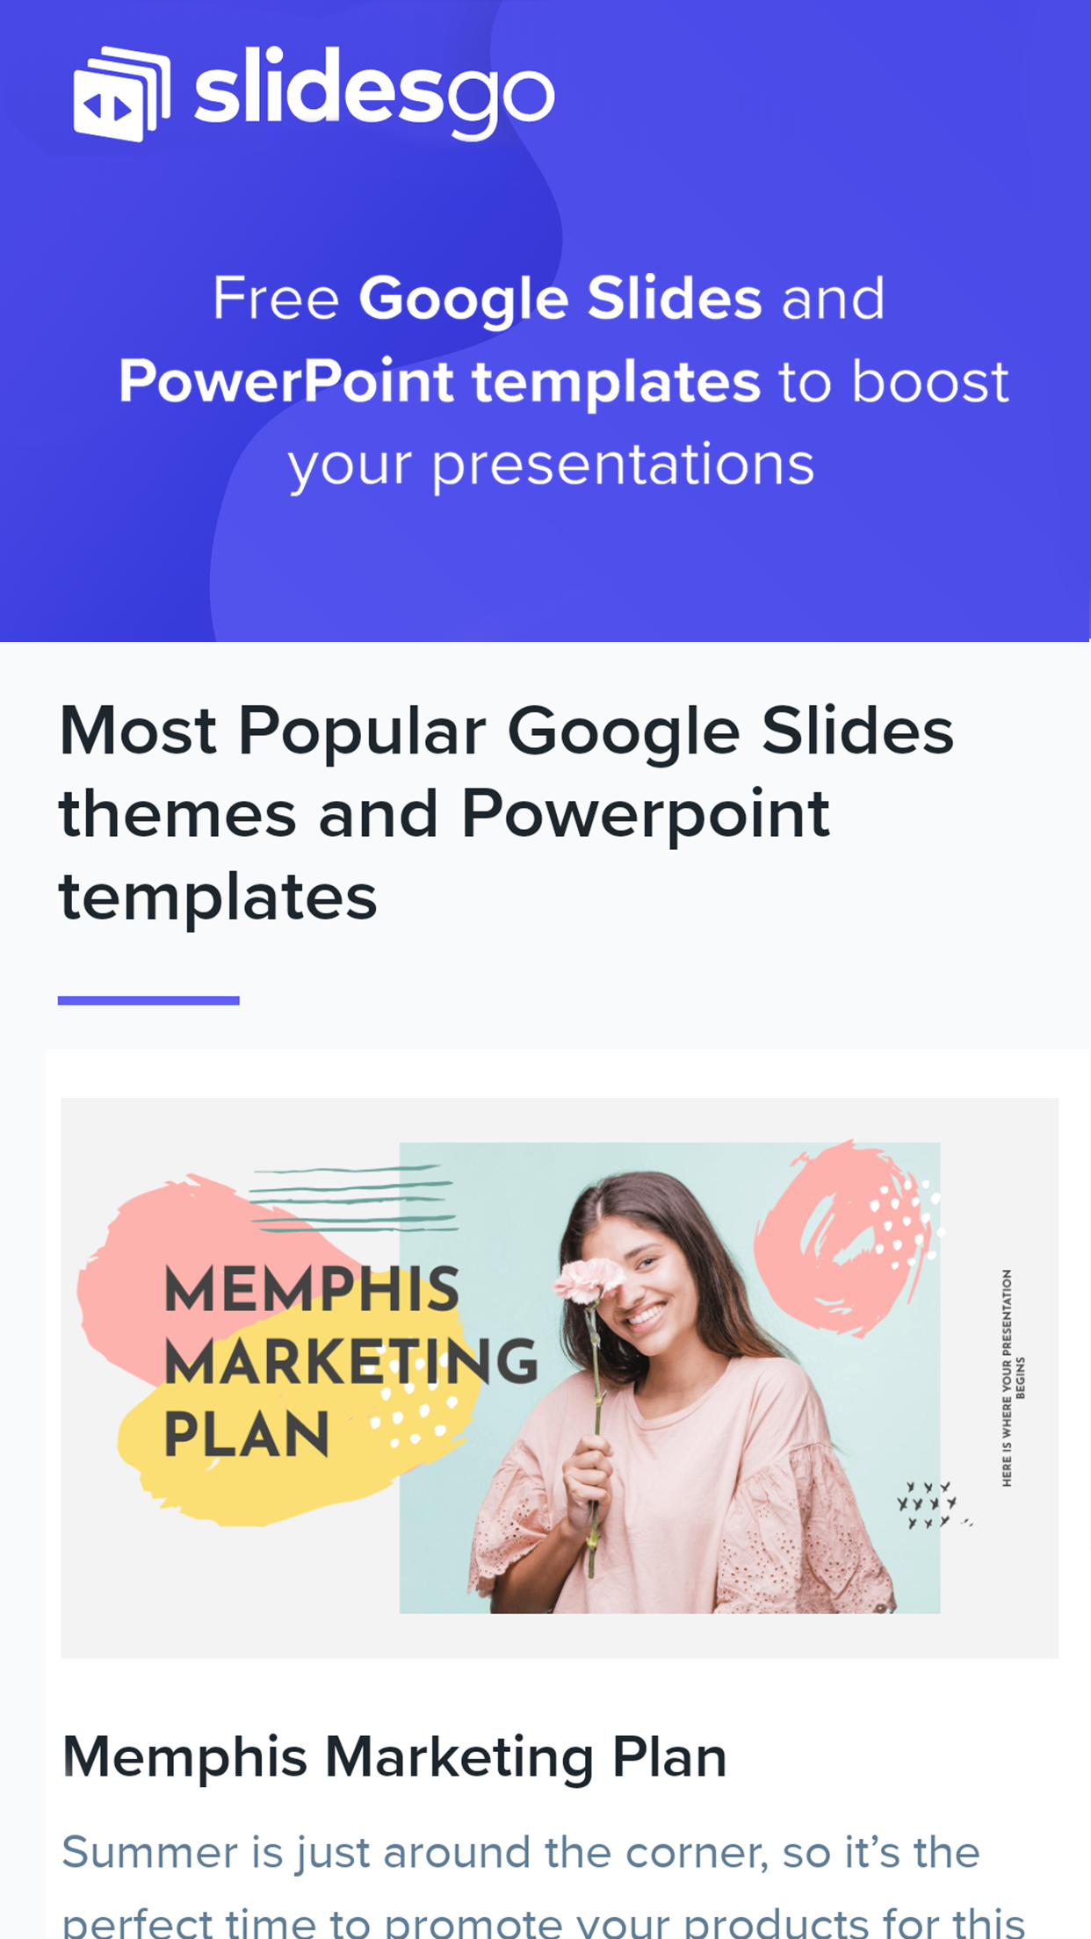
SNEAK PEEK
Neptune is the farthest planet from the Sun and the fourth-largest in our Solar System

Slide 49
RESOURCES
Did you like the resources on this template? Get them for free at our other websites.
VECTORS
Technology background with gradient colors
Blue 5g concept background
Abstract landing pages with technology devices
PHOTOS
Woman using smartphone with hologram
Happy businesswoman looking at camera with holding pencil and diary
Portrait of smiling man holding digital tablet looking at camera
Smiling bearded man holding disposable coffee cup while opening door
Portrait of pretty woman holding laptop looking at camera
Motherboard with optical fiber

Slide 50
Instructions for use (free users)
In order to use this template, you must credit Slidesgo by keeping the Thanks slide.
You are allowed to:
Modify this template.
Use it for both personal and commercial purposes.
You are not allowed to:
Sublicense, sell or rent any of Slidesgo Content (or a modified version of Slidesgo Content).
Distribute this Slidesgo Template (or a modified version of this Slidesgo Template) or include it in a database or in any other product or service that offers downloadable images, icons or presentations that may be subject to distribution or resale.
Use any of the elements that are part of this Slidesgo Template in an isolated and separated way from this Template.
Delete the “Thanks” or “Credits” slide.
Register any of the elements that are part of this template as a trademark or logo, or register it as a work in an intellectual property registry or similar.
For more information about editing slides, please read our FAQs or visit Slidesgo School:
https://slidesgo.com/faqs and https://slidesgo.com/slidesgo-school

Slide 51
Instructions for use (premium users)
In order to use this template, you must be a Premium user on Slidesgo.
You are allowed to:
Modify this template.
Use it for both personal and commercial purposes.
Hide or delete the “Thanks” slide and the mention to Slidesgo in the credits.
Share this template in an editable format with people who are not part of your team.
You are not allowed to:
Sublicense, sell or rent this Slidesgo Template (or a modified version of this Slidesgo Template).
Distribute this Slidesgo Template (or a modified version of this Slidesgo Template) or include it in a database or in any other product or service that offers downloadable images, icons or presentations that may be subject to distribution or resale.
Use any of the elements that are part of this Slidesgo Template in an isolated and separated way from this Template.
Register any of the elements that are part of this template as a trademark or logo, or register it as a work in an intellectual property registry or similar.
For more information about editing slides, please read our FAQs or visit Slidesgo School:
https://slidesgo.com/faqs and https://slidesgo.com/slidesgo-school

Slide 52
Fonts & colors used
This presentation has been made using the following fonts:
Exo 2
(https://fonts.google.com/specimen/Exo+2)
Roboto Condensed
(https://fonts.google.com/specimen/Roboto+Condensed)
#092a5c
#00ffcd
#ffffff

Slide 53





Storyset
Create your Story with our illustrated concepts. Choose the style you like the most, edit its colors, pick the background and layers you want to show and bring them to life with the animator panel! It will boost your presentation. Check out How it Works.
Pana
Amico
Bro
Rafiki
Cuate

Slide 54
Use our editable graphic resources...
You can easily resize these resources without losing quality. To change the color, just ungroup the resource and click on the object you want to change. Then, click on the paint bucket and select the color you want. Group the resource again when you’re done. You can also look for more infographics on Slidesgo.

Slide 57
JANUARY
FEBRUARY
MARCH
APRIL
MAY
JUNE
PHASE 1
Task 1
Task 2
PHASE 2
Task 1
Task 2
JANUARY
FEBRUARY
MARCH
APRIL
PHASE 1
Task 1
Task 2

Slide 60
...and our sets of editable icons
You can resize these icons without losing quality.
You can change the stroke and fill color; just select the icon and click on the paint bucket/pen.
In Google Slides, you can also use Flaticon’s extension, allowing you to customize and add even more icons.

Slide 61
Educational Icons
Medical Icons

Slide 62
Business Icons
Teamwork Icons

Slide 63
Help & Support Icons
Avatar Icons

Slide 64
Creative Process Icons
Performing Arts Icons

Slide 65
Nature Icons

Slide 66
SEO & Marketing Icons

Slide 67


